Slide 1
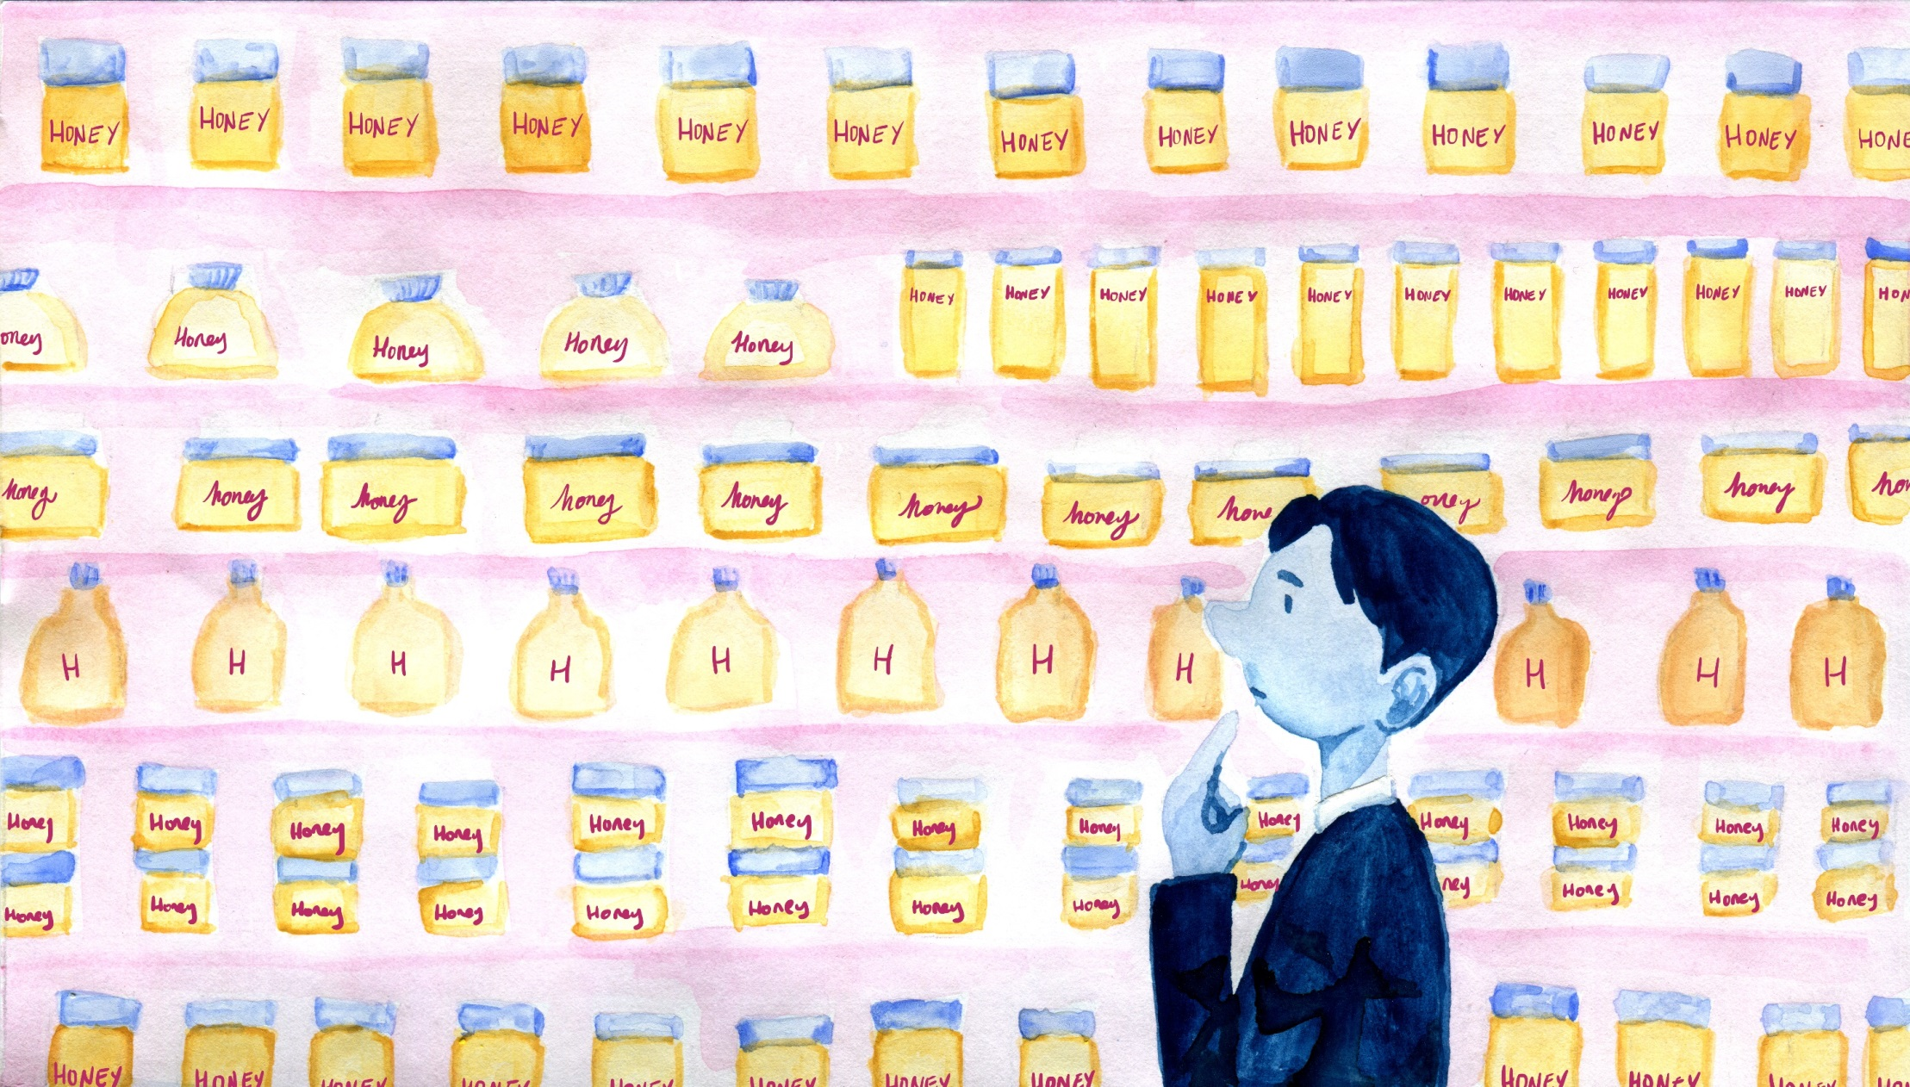
You can see the product of bees everywhere
Notes:
CREDIT NOTE: Illustrations by Helen Towrie www.helentowrie.com
You see the product of bees everywhere. You can buy it easily in almost any shop

Slide 2

Just like you see the products of engineers
Notes:
Just like you see the product of engineers everywhere (everything in picture in manmade)

Slide 3
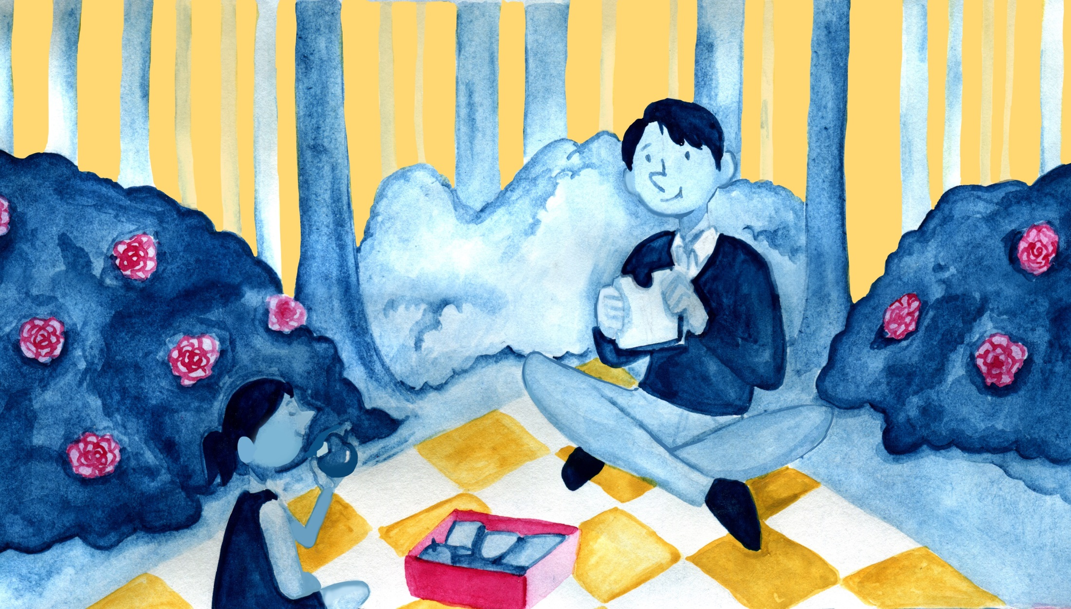
But you don’t often see the bees
- even though the bees are super important!
Notes:
But, you don’t often see bees because there aren’t many of them – even though bees are super important!

Slide 4
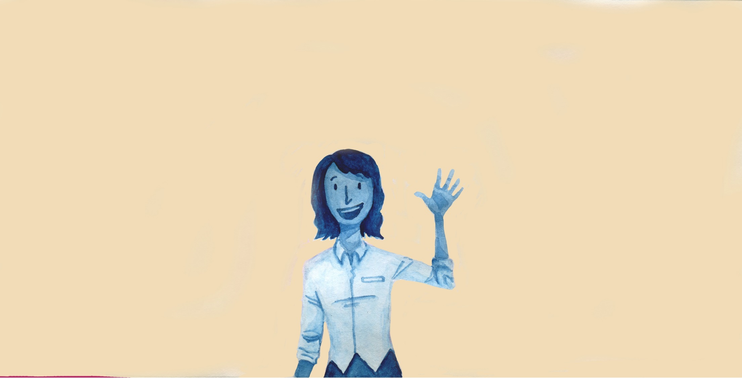
Engineers are the same
There aren’t many of them …
Notes:
Engineers are the same. There aren’t many of them…

Slide 5

… even though they make everything
Notes:
even though they make everything.

Slide 6
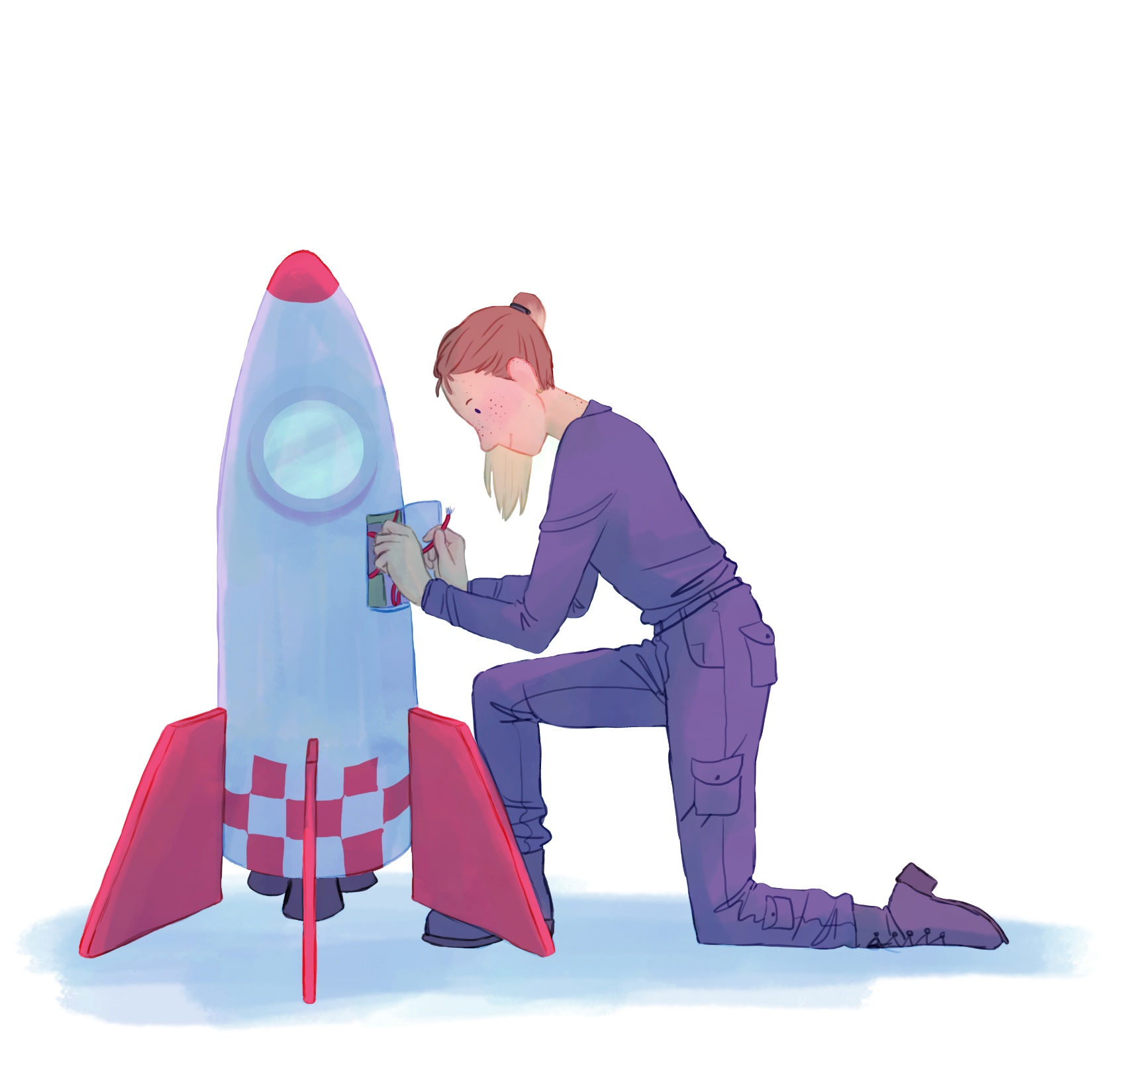
Join the team!
Notes:
So because there aren’t many of us, we need help, so we’d like you to join the team!
This is Helen’s drawing, of what she thinks she’d like to do to help find other planets, and life on other planets. We’d like you draw us a picture of yourself, helping with the search [DrawYourself.pptx]. What do you think you would like to be?

Slide 7

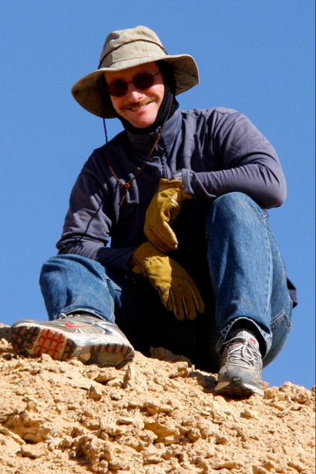
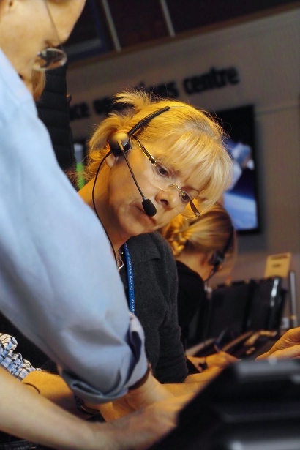
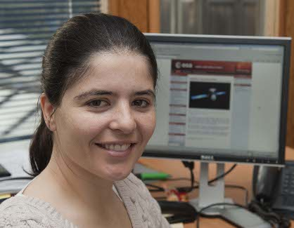
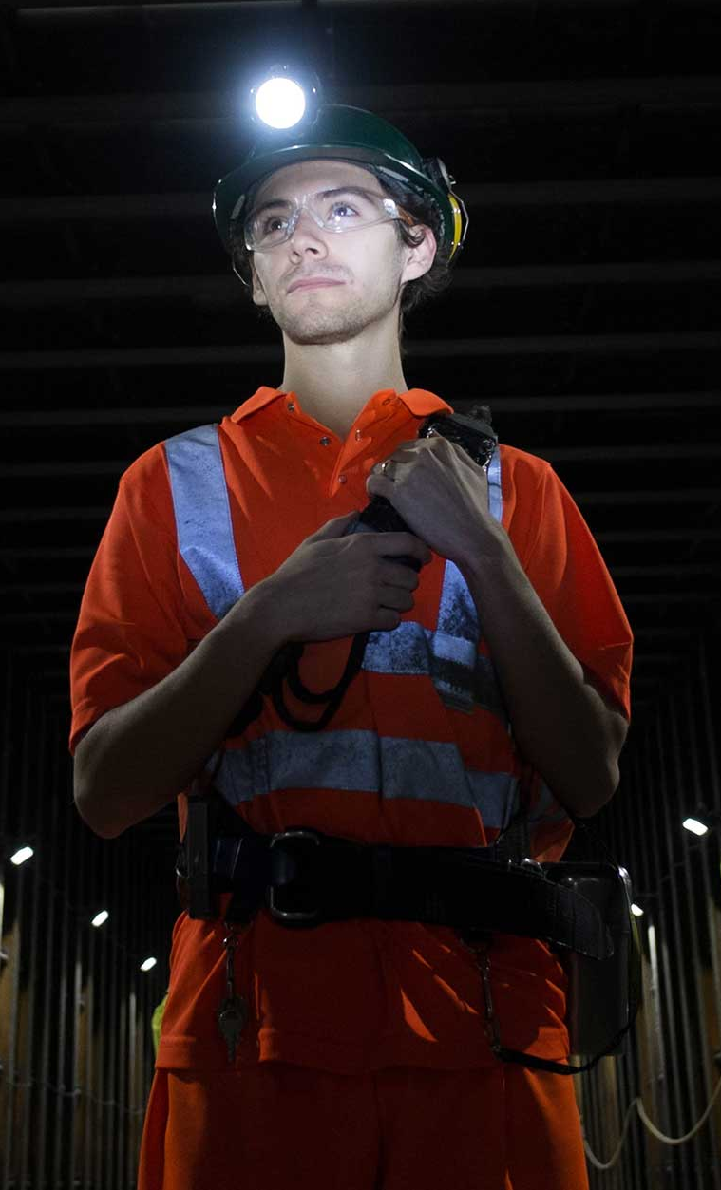
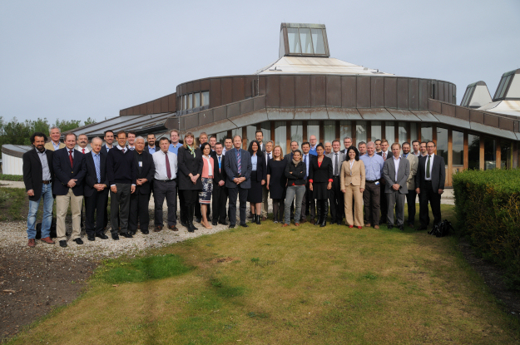

Meet the ExoMars Team!
Chris Toth: Boulby
Pia Mitschdoerfer: Mission and Software Systems Engineer
Albert Haldermann: Payload and AIV Manager
Silvia Bayon: Spacecraft Composite Systems Engineer
ESA Team
Sarah Beardsley: Head of Space Engineering and Technology, RAL Space
Notes:
Lots of different people are involved with searching for other planets, and searching for alien life.
This is the ExoMars team – they’ve got lots and lots of different people, all helping. Some, like Pia, help with the computers – and Silvia is a systems engineer, she makes sure that everything works properly together. This is Chris, and he’s in a mine – one of our labs, in Cleveland, is helping scientists figure out how to look for the signs of life, and testing the robots we’ll send out into space. Albert, up here, is the engineer in charge of testing everything for ExoMars, and this is Sarah – she works at RAL, and she’s the engineer who is in charge of what we’re doing to help ExoMars.
Now, I talked about engineers quite a lot. Who can tell me what an engineer is?
Well, we think engineers are a bit like bees.
BOTTOM LEFT: ESA team: http://exploration.esa.int/mars/56724-the-esa-exomars-team/
TOP LEFT: Pia Mitschdoerfer: ExoMars Mission & Software Systems Engineer http://exploration.esa.int/mars/49807-an-interview-with-pia-mitschdoerfer/
TOP SECOND LEFT: Silvia Bayon: ExoMars Spacecraft Composite Systems Engineer http://exploration.esa.int/mars/49747-an-interview-with-silvia-bayon/
TOP RIGHT: Albert Haldemann: ExoMars Payload and AIV Manager http://exploration.esa.int/mars/48714-an-interview-with-albert-haldemann/
BOTTOM RIGHT: Sarah Beardsley: Head of Space Engineering and Technology, RAL Space
TOP SECOND RIGHT: Chris Toth, Boulby

Slide 8
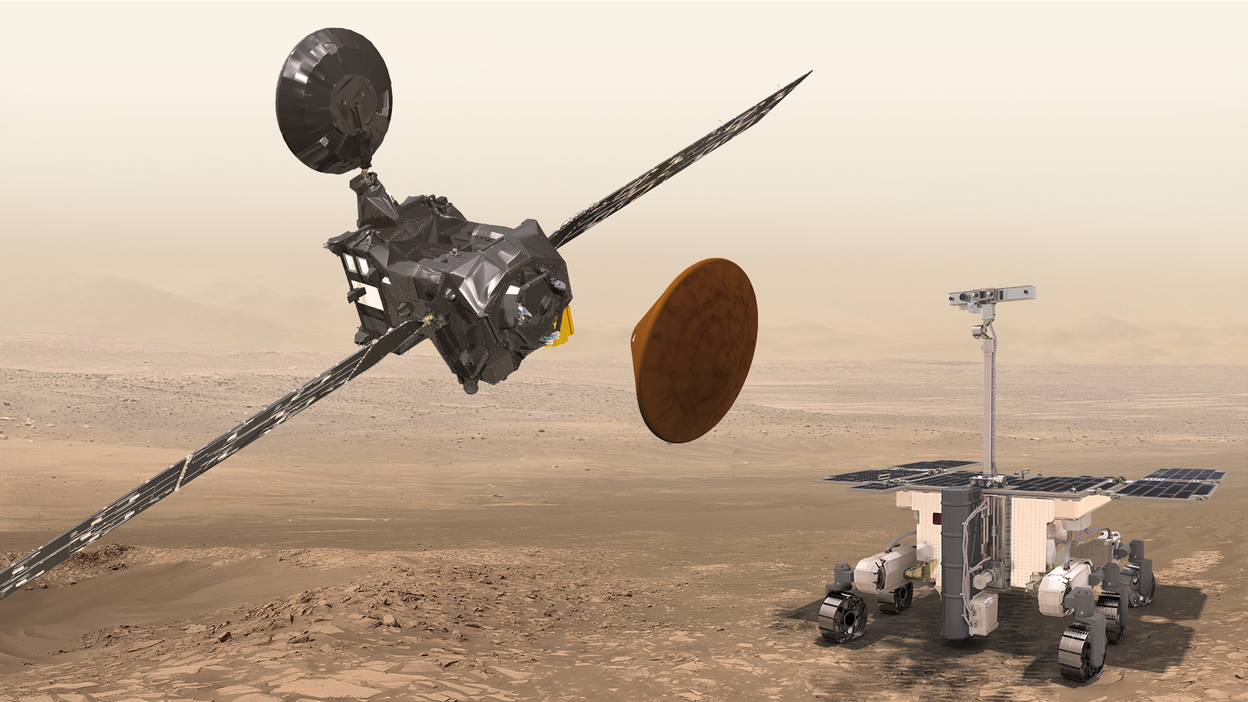
Notes:
We’re trying to find out! This is a picture of what a mission called ExoMars. ExoMars is going to Mars soon and it’s going to look for signs that, long ago, there was alien life there.
Does anybody think there could be life – probably little squiggly life – in our solar system?

